Slide 2
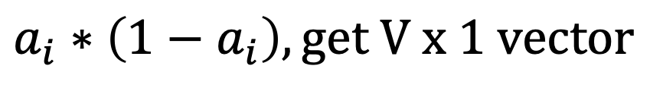
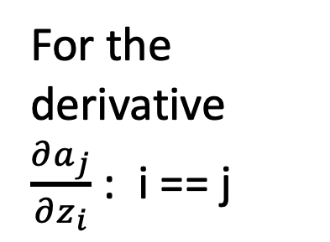
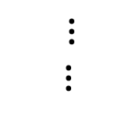



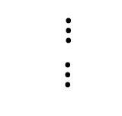


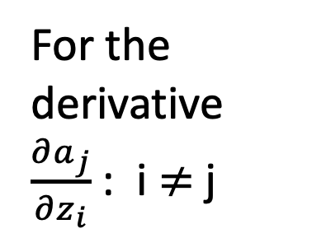


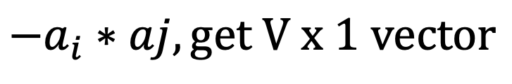
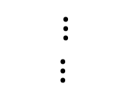







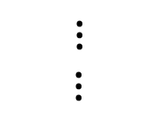





For the derivative $\frac{∂a_{j}}{∂z_{i}}$ : i == j
For the derivative $\frac{∂a_{j}}{∂z_{i}}$ : i $≠$j
$$0$$
$$a_{1}$$
$${−a}_{i}$$
$$a_{1}$$
$$a_{1}$$
$${−a}_{i}$$
$$a_{2}$$
$$0$$
$$a_{2}$$
$$a_{2}$$
$⋮$
$⋮$
$⋮$
$⋮$
$$a_{i}$$
$${1−a}_{i}$$
$$a_{i}$$
$${−a}_{i}$$
$$0$$
$$a_{i}$$
$⋮$
$⋮$
$⋮$
$⋮$
$$0$$
$$a_{V}$$
$${−a}_{i}$$
$$a_{v}$$
$$a_{V}$$
$$a_{i}∗\left(1−a_{i}\right), get V x 1 vector$$
$${−a}_{i}∗aj, get V x 1 vector$$

Slide 3
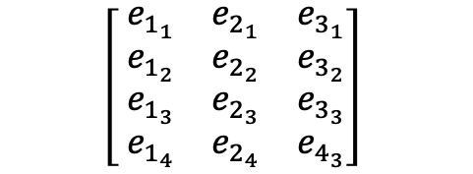
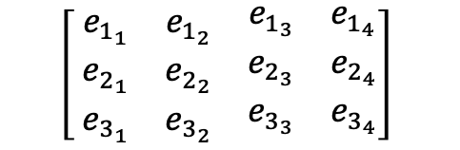

Can think of K as activation
First word embedding vector
$$\left[ \begin{matrix}e_{1_{1}} & e_{1_{2}} & \begin{matrix}e_{1_{3}} & e_{1_{4}}\end{matrix} \\ e_{2_{1}} & e_{2_{2}} & \begin{matrix}e_{2_{3}} & e_{2_{4}}\end{matrix} \\ e_{3_{1}} & e_{3_{2}} & \begin{matrix}e_{3_{3}} & e_{3_{4}}\end{matrix}\end{matrix}\right]$$
$$\left[ \begin{matrix}e_{1_{1}} & e_{2_{1}} & e_{3_{1}} \\ e_{1_{2}} & e_{2_{2}} & e_{3_{2}} \\ \begin{aligned}e_{1_{3}} \\ e_{1_{4}}\end{aligned} & \begin{aligned}e_{2_{3}} \\ e_{2_{4}}\end{aligned} & \begin{aligned}e_{3_{3}} \\ e_{4_{3}}\end{aligned}\end{matrix}\right]$$
$$×$$

